Slide 1

Load and stress test
Amit grumet

Slide 2



Support in up to 1000 stores
1000 users in the same time
Support of up to 1,000,000 purchase history.

Slide 3

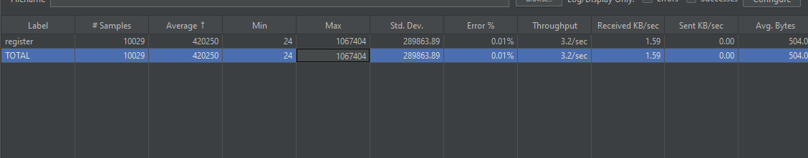
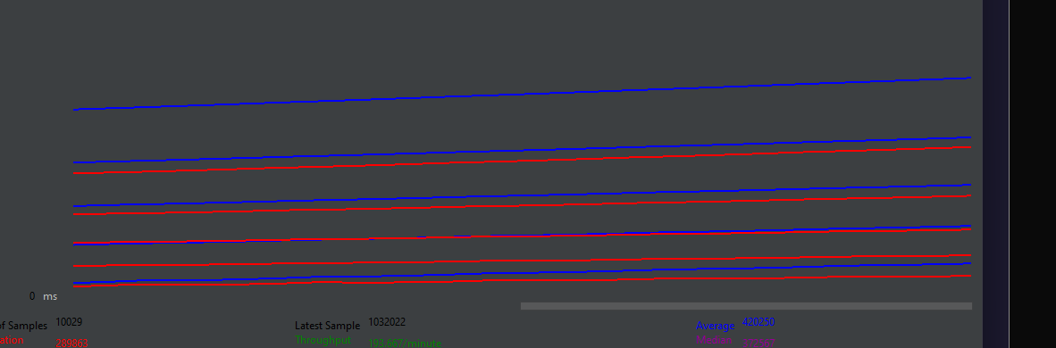
10,000 registers and logged users at the same time

Slide 4
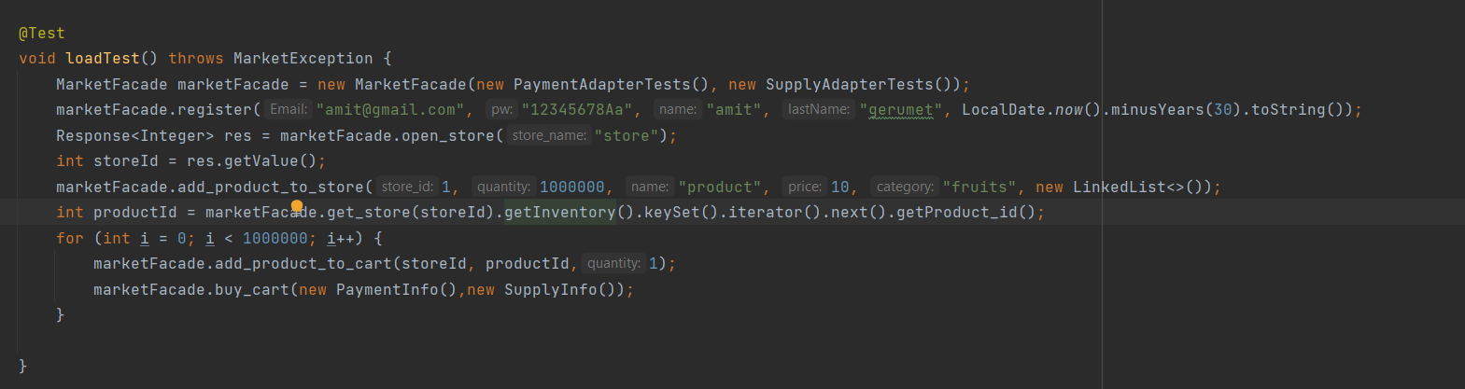
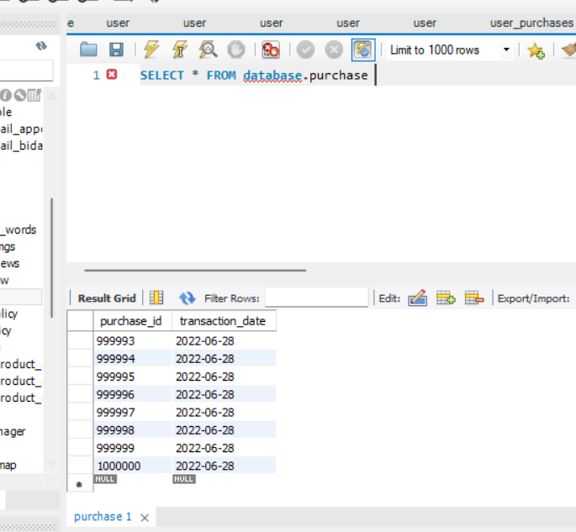
Million purchases history

Slide 5
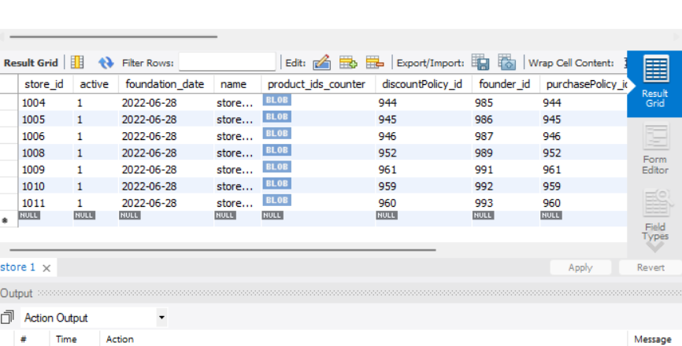
1000 stores

